Slide 1
Stroke and Turn Officials Certification Clinic
prepared for
MCAL

Slide 2
Fair and Equitable
Judging should be consistent among different officials at a meet
Judging should be consistent at different meets
All of the rules are enforced, we don’t individually choose to enforce some rules and ignore others

Slide 3
Fair and Equitable (Cont’d)
The rules are enforced across all age groups and levels of ability
Officials should be neutral in their enforcement of the rules; don’t favor one team over another, don’t favor one swimmer over another

Slide 4
Mental Traps
Advantage vs. disadvantage
The “twice theory”
“We don’t disqualify 8 & unders”
“Don’t ask me to judge my child”
Don’t infer…
Call what you see, not what you don’t see

Slide 5
Rules of Thumb
The benefit of the doubt ALWAYS goes to the swimmer
Ugly isn’t (necessarily) illegal
Know the rules; review the rules before meets
Experience, experience, experience

Slide 6
The Golden Rule…

Slide 7
Butterfly
Start
The forward start shall be used
Stroke
After the start and each turn, the shoulder’s must be at or past vertical toward the breast
Swimmer is permitted one or more leg kicks, but only one arm pull under water, which must bring the swimmer to the surface
Swimmer cannot be submerged for a distance greater than 15 meters (16.4 yards) after the start and each turn at which time the head must have broken the surface

Slide 8
Butterfly (Cont’d)
Swimmer must remain on the surface until the next turn or finish
From the beginning of the first arm pull, the body shall be kept on the breast
Both arms must be brought forward over the water and pulled back simultaneously
Kick
All up and down movements of the legs and feet must be simultaneous

Slide 9
Butterfly (Cont’d)
The position of the legs or the feet need not be on the same plane, but shall not alternate in relation to each other
A scissors or breaststroke kicking movement is not permitted
Turns
At each turn the body shall be on the breast
The touch shall be made with both hands simultaneously at, above or below the water surface
Once a touch has been made, the swimmer may turn in any manner
The shoulders must be at or past vertical toward the breast when the swimmer leaves the wall

Slide 10
Butterfly (Cont’d)
Finish
At the finish, the body shall be on the breast and the touch shall be made with both hands simultaneously at, above or below the water surface

Slide 11
Backstroke
Start
The simmers shall line up in the water facing the starting end with both hands placed on the gutter or on the starting grips
Standing in or on the gutter, placing the toes above the lip of the gutter or bending the toes over the lip of the gutter before or after the start is prohibited

Slide 12
Backstroke (Cont’d)
Stroke
The swimmer shall push off on his back and continue swimming on the back throughout the race except it is permissible for the swimmer to be completely submerged during the turn, at the finish and for a distance of not more than 15 meters (16.4 yards) after the start and each turn
By that point, the head must have broken the surface of the water

Slide 13
Backstroke (Cont’d)
Turns
Upon completion of each length, some part of the swimmer must touch the wall
During the turn, the shoulders may be turned past the vertical toward the breast after which a continuous simultaneous double arm pull may be used to execute the turn
The swimmer must have returned to a position on the back upon leaving the wall
Finish
Upon the finish of the race, the swimmer must touch the wall while on the back

Slide 14
Breaststroke
Start
The forward start shall be used
Stroke
From the beginning of the first arm stroke after the start and after each turn, the body shall be kept on the breast
Throughout the race, the stroke cycle must be one arm stroke and one leg kick in the that order
All movements of the arms shall be simultaneous and in the same horizontal plane without alternating movement

Slide 15
Breaststroke (Cont’d)
The hands shall be pushed forward together from the breast on, under or over the water
The elbows shall be in contact with the water except for the final stroke before the turn, during the turn and for the final stroke at the finish
The hands shall not be brought back beyond the hip line except during the first stroke after the start and each turn
During each complete cycle, some part of the swimmer’s head shall break the surface of the water

Slide 16
Breaststroke (Cont’d)
After the start and each turn, the swimmer may take one arm stroke completely back to the legs
The head must break the surface of the water before the hands turn inward at the widest part of the second stroke
Kick
After the start and each turn, a single downward butterfly kick followed by a breaststroke kick is permitted while wholly submerged
Following which, all movements of the legs shall be simultaneous and in the same horizontal plane without alternating movement

Slide 17
Breaststroke (Cont’d)
The feet must be turned outwards during the propulsive part of the kick
A scissors, flutter or downward butterfly kick is not permitted except as provided herein
Breaking the surface of the water with the feet is allowed unless followed by a downward butterfly kick

Slide 18
Breaststroke (Cont’d)
Turns and Finish
At each turn and at the finish, the touch shall be made with both hands simultaneously at, above or below the water surface
The head may be submerged after the last arm pull prior to the touch, provided it breaks the surface of the water at some point during the last complete or incomplete cycle preceding the touch

Slide 19
Freestyle
Start
The forward start shall be used
Stroke
In an event designated freestyle, the swimmer may swim any style, except that in a medley relay or an individual medley event; freestyle means any style other than butterfly, breaststroke or backstroke

Slide 20
Freestyle (Cont’d)
Some part of the swimmer must break the surface of the water throughout the race, except it shall be permissible for the swimmer to be completely submerged during the turn and for a distance of not more than 15 meters (16.4 yards) after the start and each turn at which point the head must have broken the surface
Turns
Upon completion of each length, the swimmer must touch the wall

Slide 21
Freestyle (Cont’d)
Finish
The swimmer shall have finished the race when any part of the body touches the wall after completing the prescribed distance

Slide 22
Individual Medley
The swimmer shall swim the prescribed distance in the following order: the first ¼ = butterfly, the second ¼ = backstroke, the third ¼ = breaststroke and the last ¼ = freestyle
Start
The forward start shall be used
Stroke
The stroke for each ¼ of the designated distance shall follow the prescribed rules for that stroke

Slide 23
Individual Medley (Cont’d)
Turns
Intermediate turns within each stroke shall conform to the turn rules for that stroke
The turns when changing from one stroke to another shall conform to the finish rules for the stroke just completed and shall be as follows:
Butterfly to Backstroke – The swimmer must touch as previously described. Once a legal touch has been made, the swimmer may turn in any manner but the shoulders must be at or past vertical toward the back when the swimmer leaves the wall.

Slide 24
Individual Medley (Cont’d)
Backstroke to Breaststroke – The swimmer must touch the wall while on the back. Once a legal touch has been made, the swimmer may turn in any manner but the shoulders must be at or past vertical toward the breast when the swimmer leaves the wall and prescribed breaststroke form must be attained prior to the first arm stroke.
Breaststroke to Freestyle – The swimmer must touch as previously described. Once a legal touch has been made, the swimmer may turn in any manner.
Finish
The swimmer shall have finished the race when any part of the body touches the wall after the prescribed distance

Slide 25
Medley Relay Infractions
Strokes not swum in proper order
Violation of stroke and turn rules for each stroke
The last ¼ of the race must be swum as something other than butterfly, backstroke, or breaststroke
Early take-off

Slide 26
Freestyle Relay Infractions
Violation of freestyle stroke and turn rules
Early take-off

Slide 27
All Strokes
The Rules and Regulations Committee adopted the following parameters regarding touching the bottom during a turn:
Once a legal touch has been made, the swimmer may turn in any manner desired. Therefore, standing on the bottom after a legal touch has been made and prior to pushing off the wall should be considered part of the turn and no DQ should be called.

Slide 28
Additional Rules
A swimmer must start and finish in the same lane
Standing on the bottom during a freestyle race shall not disqualify a swimmer, but a swimmer must not leave the pool, or walk, or spring from the bottom. Standing on the bottom during any other stroke shall result in disqualification
Obstructing another swimmer by swimming across or otherwise interfering shall disqualify the offender, subject to the discretion of the Referee

Slide 29
Jurisdiction of Officials
Determined by Referee or Chief Judge
Turn Judges
Start
From the start of the race to the first complete arm stroke
Turn
From the beginning of the last arm stoke before touching and ending with the completion of the first arm stroke after turning
Finish
ensure that the swimmers finish according to the rules

Slide 30
Jurisdiction of Officials (Cont’d)
Stroke Judges
“Wall to wall” from the start to the finish
Equal time should be spent observing each of the swimmers within your jurisdiction
If one or more lanes are empty, an equal amount of time should be spent on the empty lane(s)
Your full attention should be on the swimmers when they are within your jurisdiction

Slide 31
Disqualifications
Raise a hand overhead on observing a violation of the rules that occurs within your jurisdiction
Keep your hand up long enough for the Referee/Chief Judge to see it
If you raise your hand…
…you don’t have to make a call;
if you don’t raise your hand…
…you can’t make a call

Slide 32
Disqualifications (Cont’d)
If you’re hesitant in raising your hand, the call was probably too close to make
The benefit of the doubt goes to the swimmer
After signaling a DQ, continue to observe all the swimmers in your jurisdiction

Slide 33
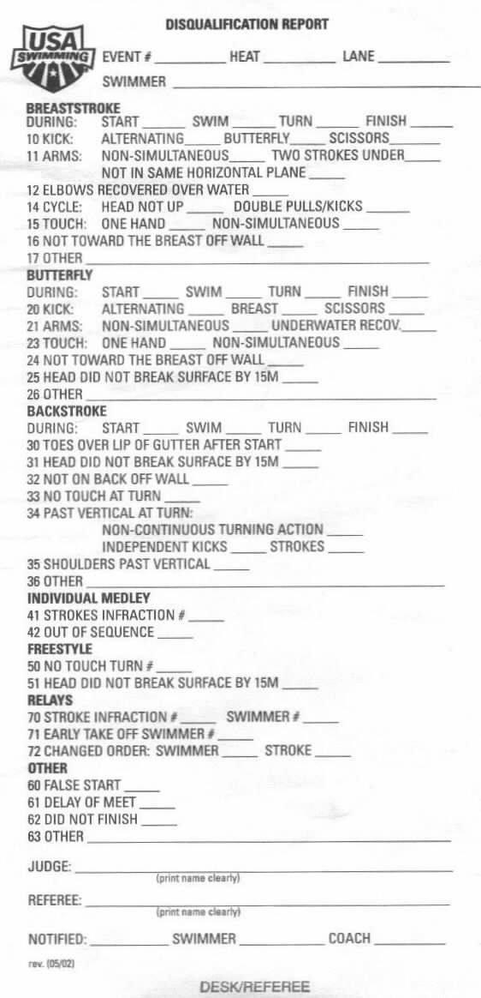
Disqualification Reports
Confirmed name of swimmer
Event #, Heat #, Event name
Violation
Note: Most, but not all, violations are listed on the DQ slips
Your signature
Referee’s signature

Slide 35
Disqualification Reports (Cont’d)
The Referee or Chief Judge must approve the DQ
Be prepared to answer three questions:
What was your jurisdiction?
Where were you physically located at the time?
What did you see?
Use proper terminology
Which rule was violated?

Slide 36
Remember!
The swimmer always receives the benefit of the doubt
Call what you see, not what you don’t see

Slide 37
Thank you!

